Slide 1
The AEF and Consolidation of Gains Operations During the Meuse-Argonne Offensive, 1918

Slide 2
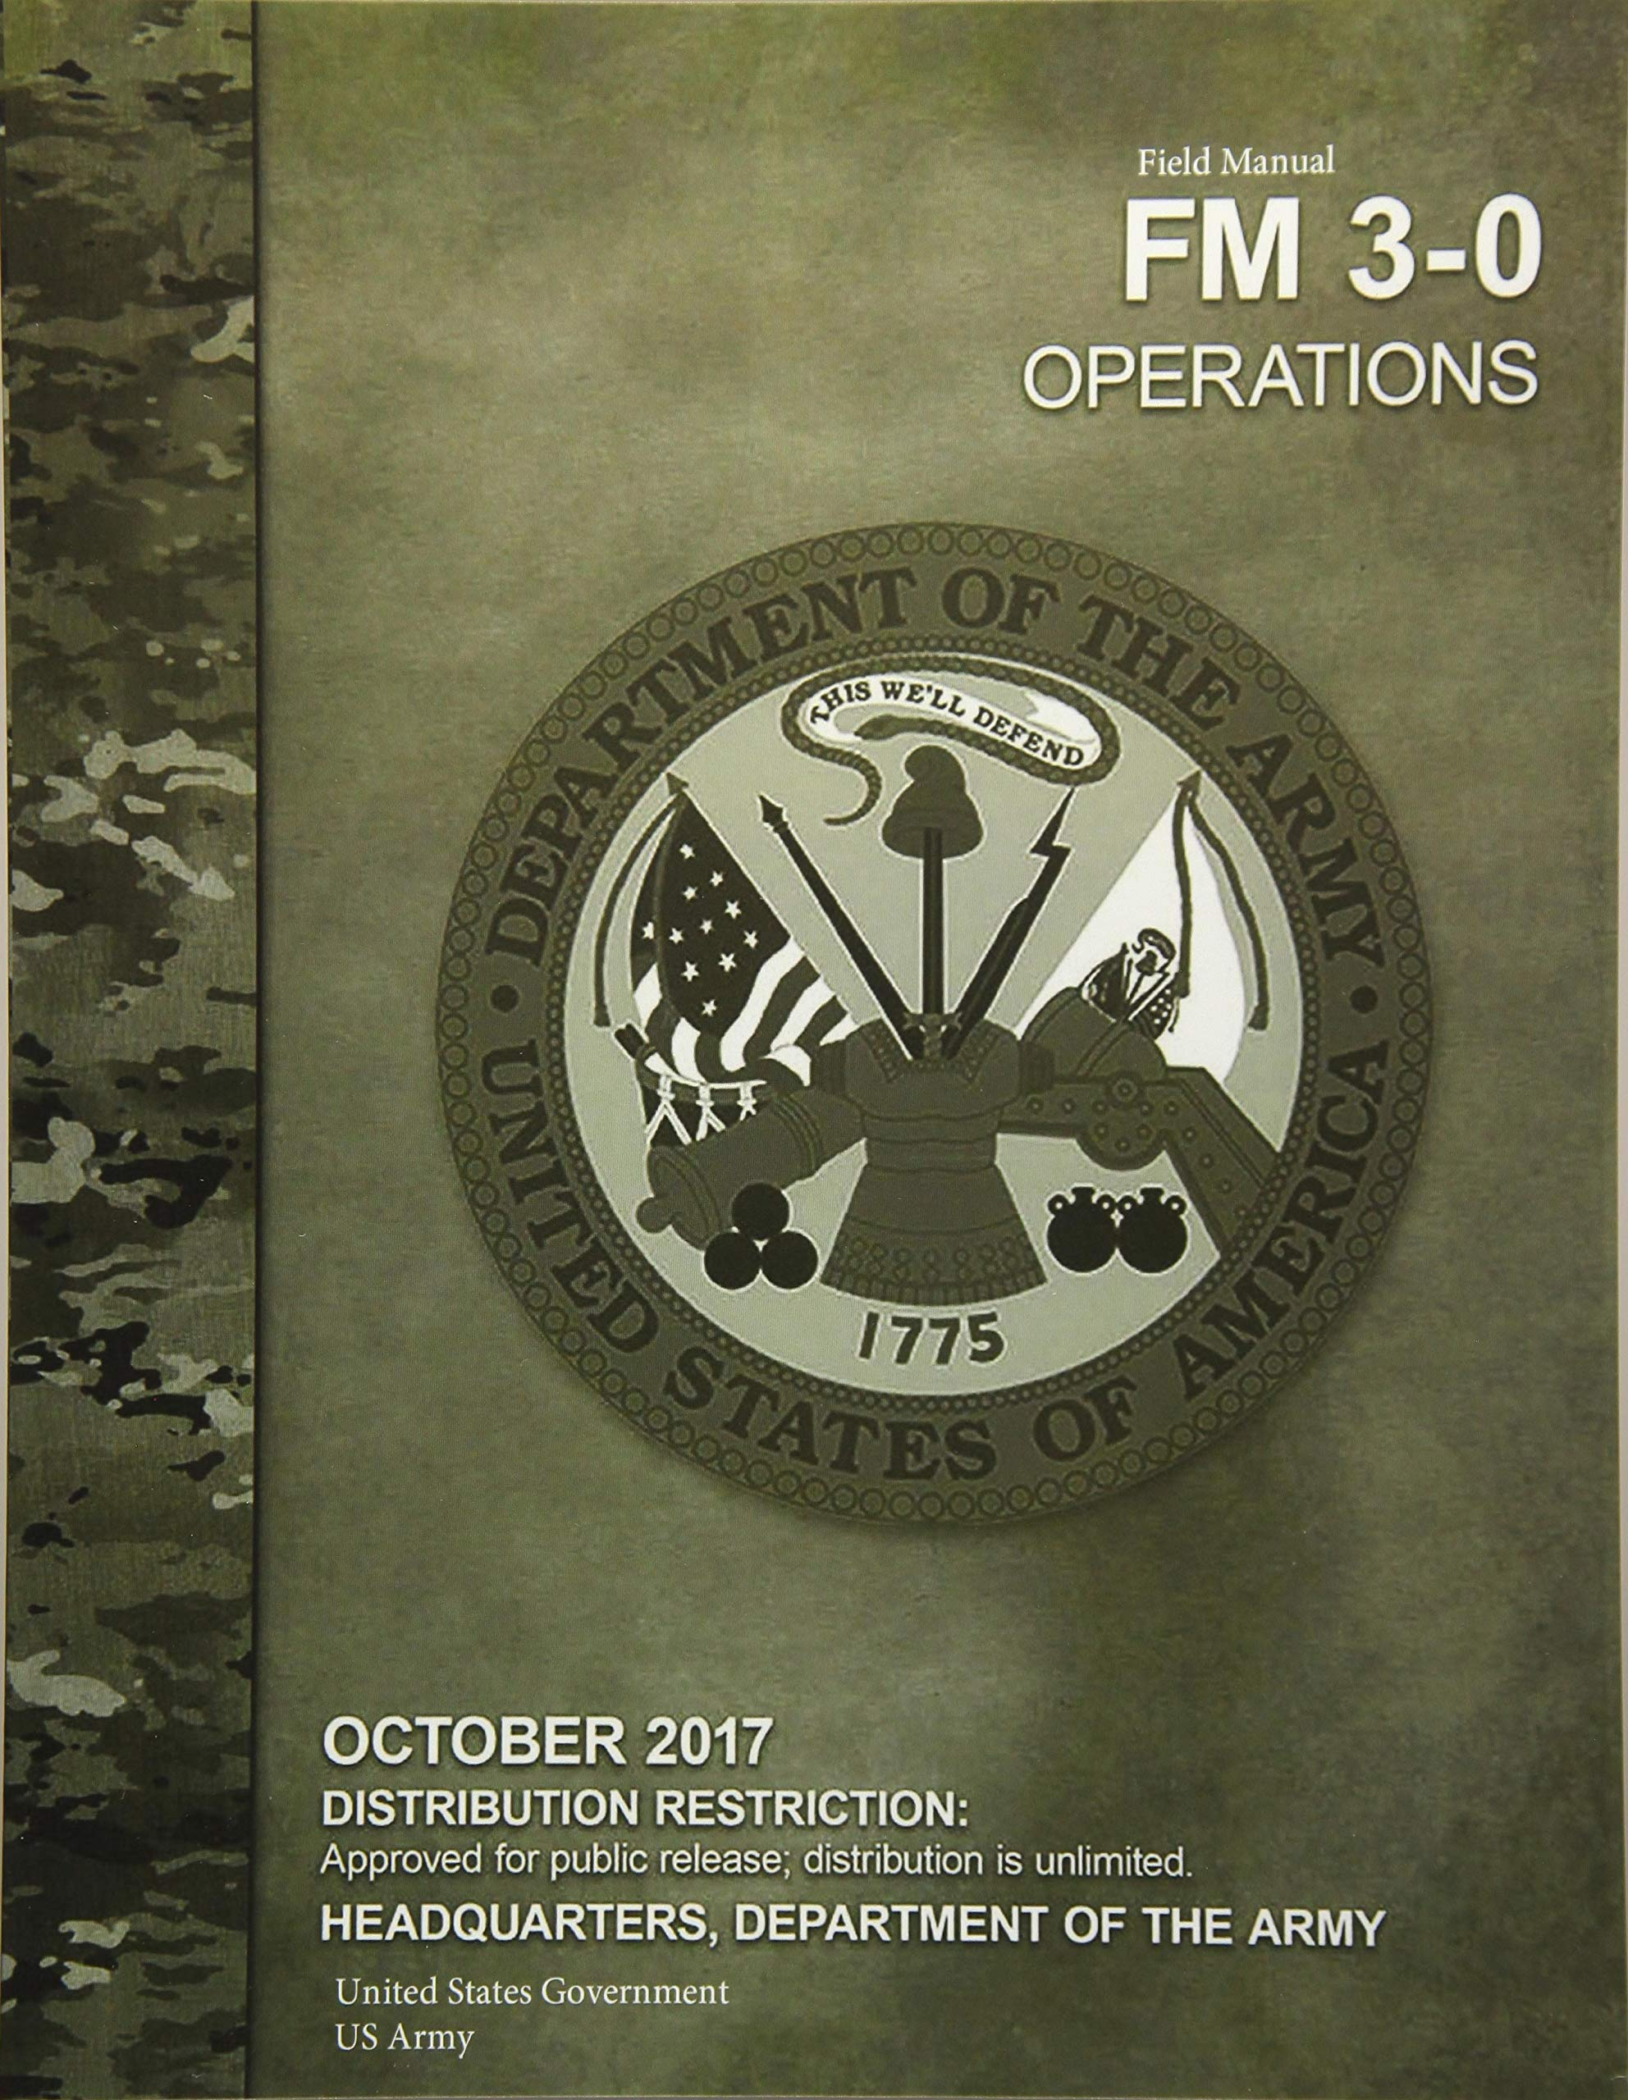
FM 3-0, Operations Consolidation of Gains
“Essential to any operation”
Removal of the enemy’s capability and will for further resistance
“integral to winning armed conflict and achieving enduring success”
“the final exploitation of tactical success”
Frontline manuever element s initiate this process and consolidation of gains operations fully capitalize on the gains made
By definition, such operations do not occur in areas of close and large-scale combat, but rather where security and stabilization are required to move the overall force forward
Maintaining seized territory while ensuring offensive momentum

Slide 3
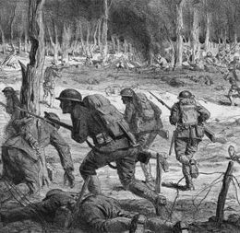
FM 3-0 and the Meuse-Argonne Offensive
Establishing and maintaining lines of transportation and communication
Clearing bypassed enemy forces (Mopping up)
Handling and interrogating EPWs
Providing medical services

Slide 4
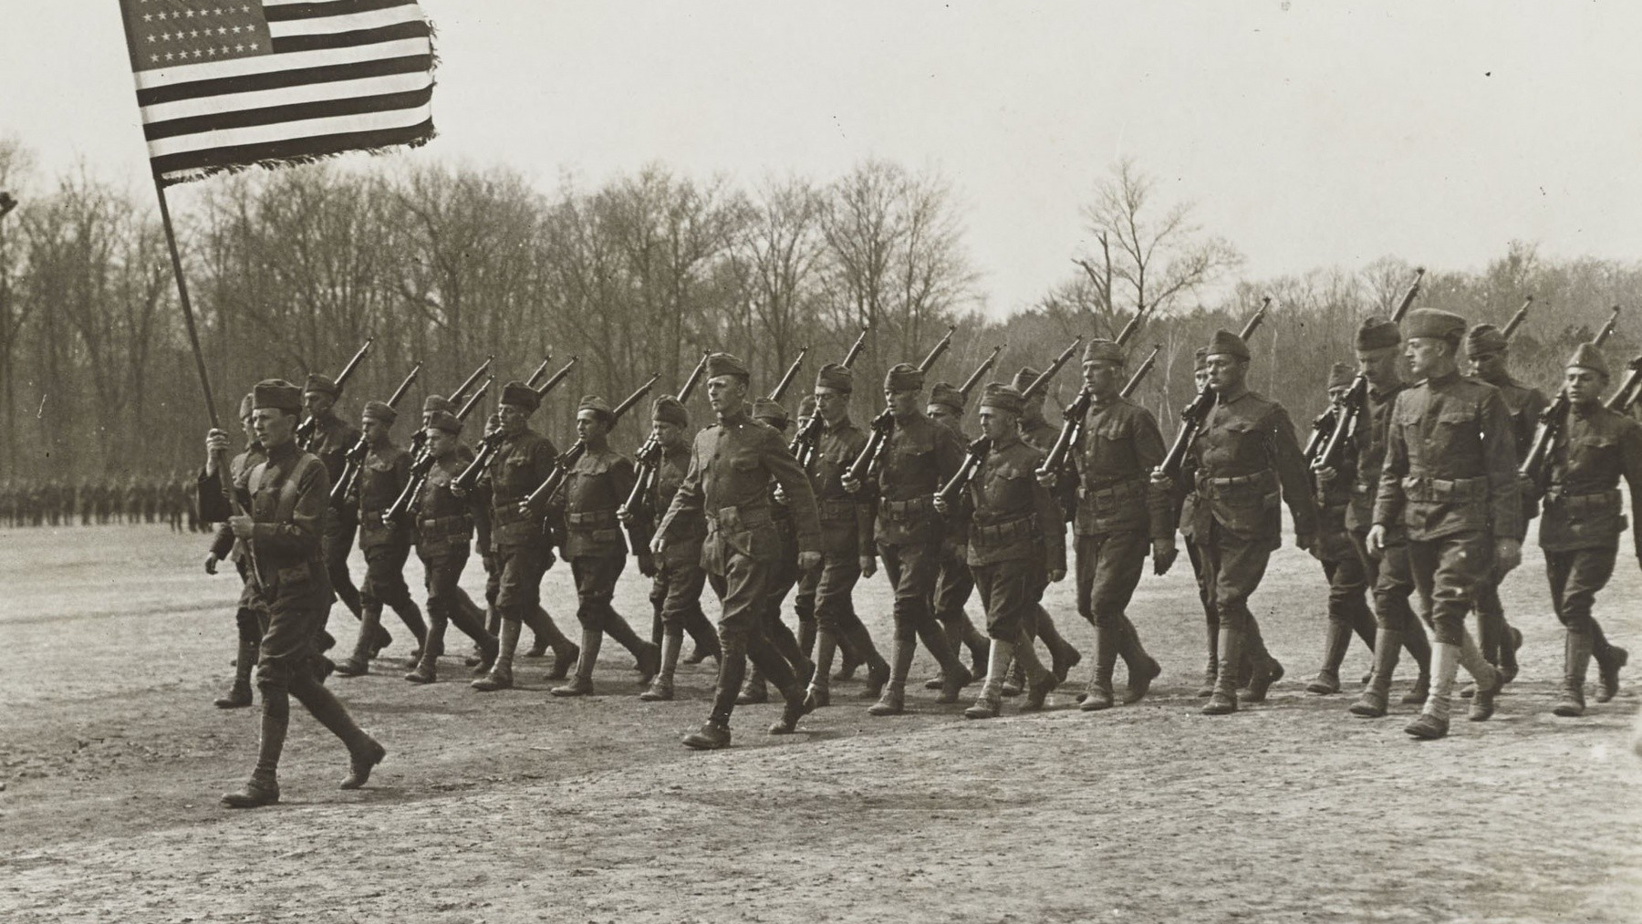
The Offensive in Context

Slide 5
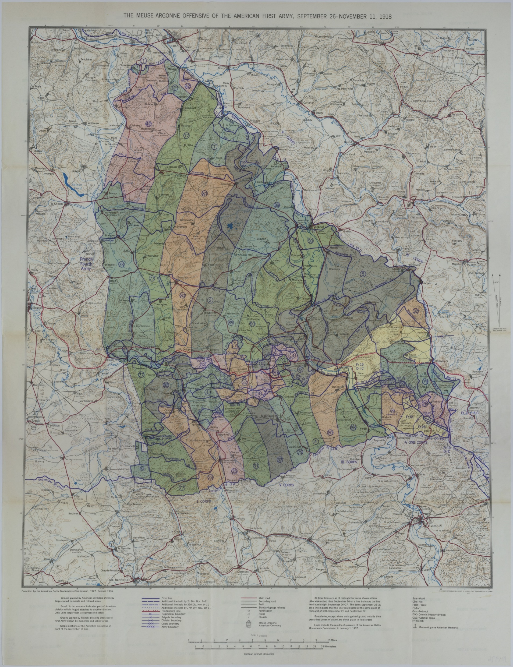
The AEF under Gen. John “Black Jack” Pershing followed the typical WWI strategy of using overwhelming force to break enemy defenses
Pershing sought to capitalize on fresher, more enthusiastic AEF against war-wary Germans
Objectives:
Break through enemy defenses and cut off German railway system
Divert German strategic deserves to the Argonne forest/Meuse River valley allowing Allied forces to attack further north
Offensive was American-led/French supported

Slide 6
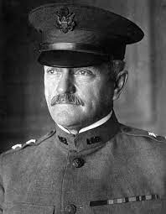
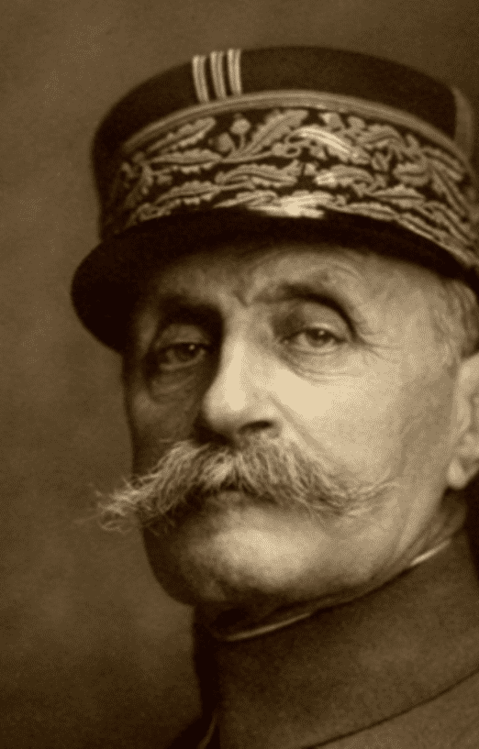
Coordinating with Allies
AEF and Allied counterparts doubt enough other
Americans resistant to integrating forces
Different training emphasis
British and French use joint training between infantry and artillery (light howitzers)
AEF use individual training on marksmanship and aggressiveness, supported by heavy artillery (French 75mm and 155mm)
Gen. John Pershing
Gen. Ferdinand Foch

Slide 7
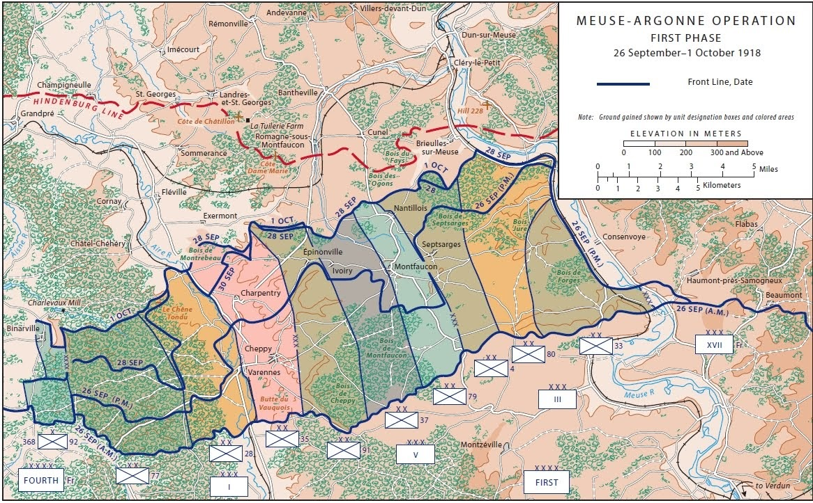
Operation born of compromise
AEF leads the offensive supported by French 4th Army
Operation begins on September 26 with the ambitious objective of the 79th seizing Montfaucon on day 1
Movement of 1 million troops plus equipment from St. Mihiel Salient in 2 weeks highlights first CoG challenge

Slide 8
Myriad traffic jams
Changes in orders
Miscommunication
Outright communication breakdown
Nevertheless, Pershing did not allow any of these issues to slow or halt the plan
CoS operations became essential to overcoming these issues

Slide 9
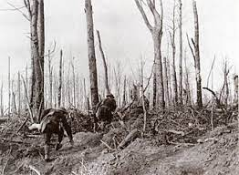
Transportation Operations
Gains cannot be consolidated if advancing forces cannot receive reinforcements, supplies, and orders
Failure to maintain lines of communication result in forces getting isolated
Ex. “The Lost Battalion”

Slide 10
Transportation Operations
Three main pre-war roads replaced with artificial obstacles, artillery and mine craters, and contact mines
Army Engineers are tasked with restoring transportation and communication lines

Slide 11
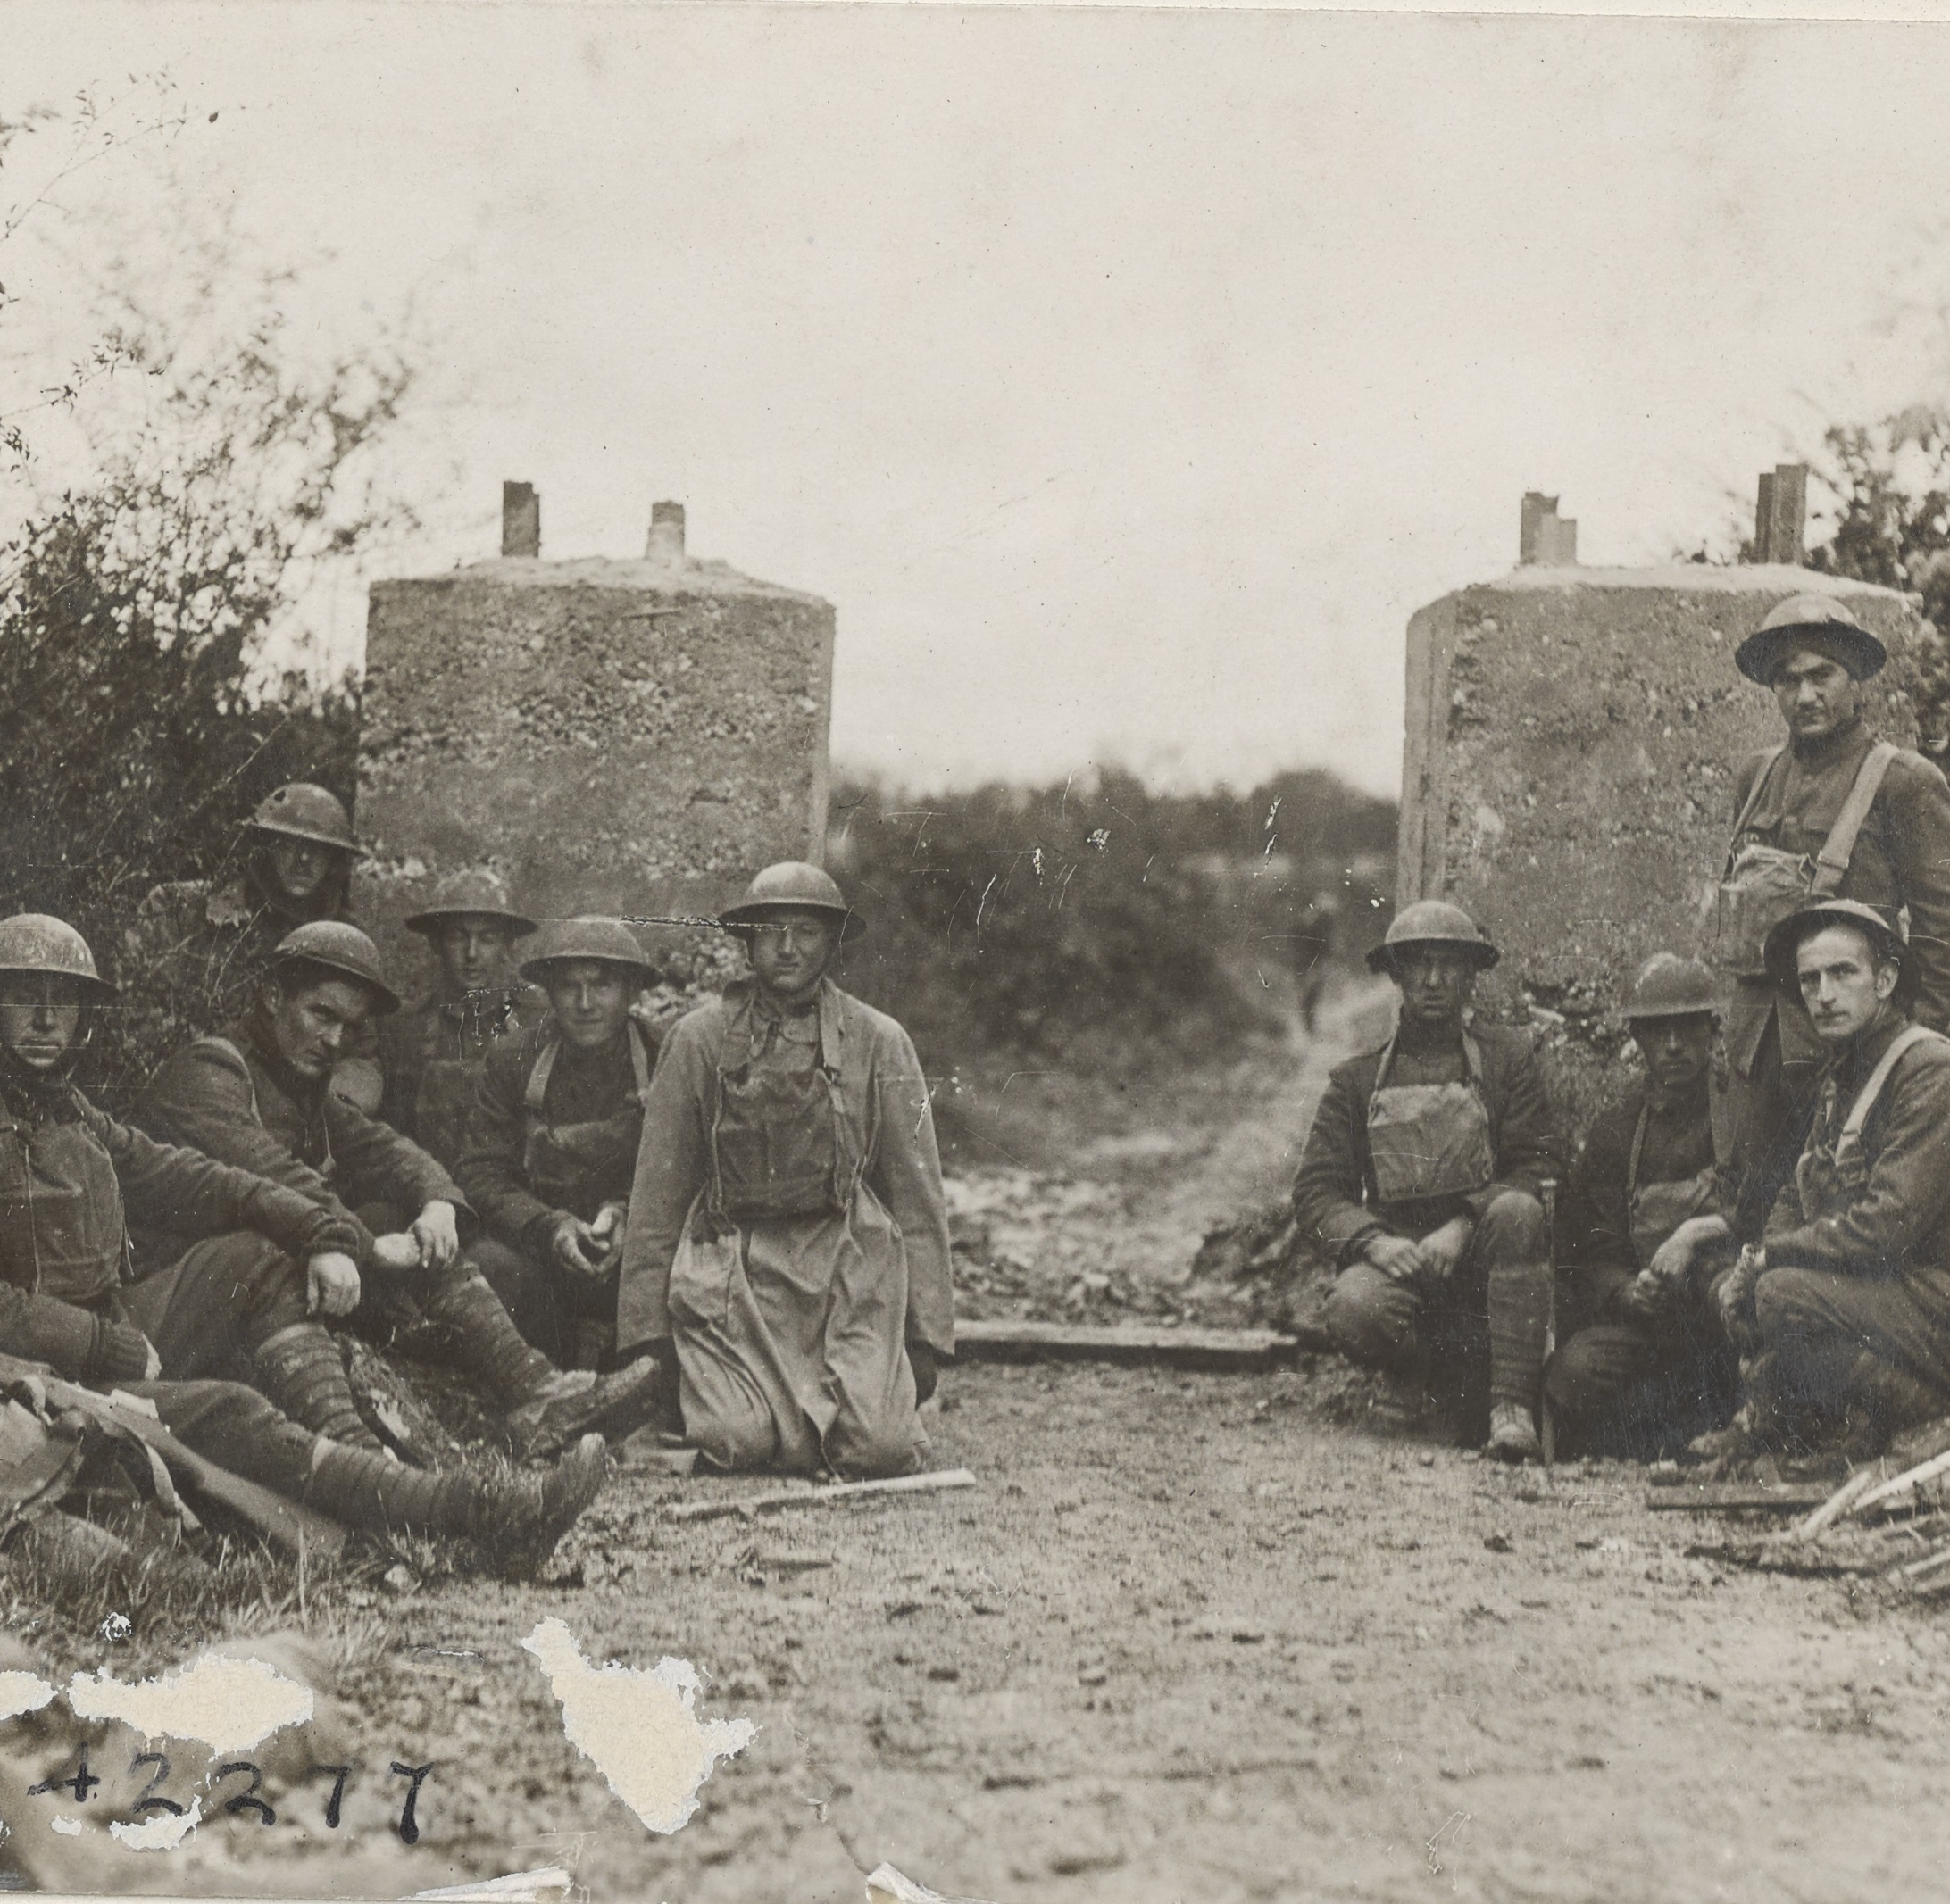
Siege of Montfaucon
“Poor communication in broken country” – Brig. Gen. Malin Craig
Army Engineers called to work roads and bridges in the area
Day One objective stays out of reach
37th and 4th Divisions seize flanking salient
79th advances but heavy traffic congestion and delayed arrival of horse-drawn artillery makes it a Day Two gain

Slide 12
Victims of Their Success
September 27 – advance is pacing faster than road repair
Artillery (105s and 155s) are delayed as infantry advances
29th Division’s 104th Engineers worked through the night
September 28 – Enhancing road conditions seen as “essential”
September 29 – road situation stabilized and remained so

Slide 13
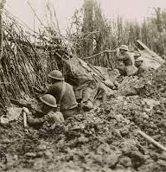
Mopping Up Operations
While enemy lines can be broken or driven back, consolidation area is only secure once remaining enemy troops have been killed or captured
September 27 – Cautionary tale of the 79th Division
304th Engineers “just in the rear of the advance” found themselves under enemy fire in a “mopped up” area of Bois de Montfaucon
Cleaned out a German machine-gun nest and took prisoners from the 117th Division and 7th Reserve
Mistake is not repeated

Slide 14
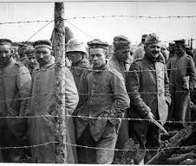
Taking Prisoners
Hundreds (sometimes thousands) of German prisoners taken by the day
Made further demands on the AEF transportation system
Throughout the campaign, German EPWs provided key intel on German Order of Battle – location, strength, and general disposition
Example – AEF was prepared for determined resistance at Dun-sur-Meuse

Slide 15
Required Restructuring
New system and methodology for interrogating prisoners developed from Meuse-Argonne campaign
Maj. Dennis Nolan (AEF Intelligence Section) recognized in earlier AEF engagements that EPW interrogation by lower echelons were impractical/inefficient
Limited personnel and high operating tempo
Nolan institutes new, more structured approach:
EPWs disarmed => Brigade HQ to search for concealed weapons and documents
Sent further back to Division enclosures under Provost Marshal General (PMG)
Interrogated by Intel Personnel=> central EPW enclosure
Many AEF intelligence personnel were from relevant professions

Slide 16
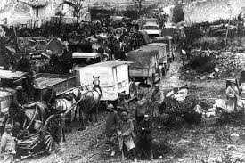
Medical Services & “The Other Enemy”
Early transportation issues also highlighted medical concerns
Shortage of medical supplies for a force that large under ideal conditions (and things were about to get worse . . .)
Beginning of the Flu Pandemic
In most cases, only palliative care available for flu/pneumonia (rest, warmth, food and fluids)

Slide 17
AEF Medical Adaptations
Developed light ambulances better able to travel from and to the front
Hospital “cities” – large interconnected field hospitals
Medical evacuation system used field hospitals to separate lightly wounded, seriously wounded, gassed, psychiatric, and sick before being moved by ambulance to mobile or evacuation hospitals farther from the front lines
More serious patients were moved by railway to base hospitals in the consolidation areas

Slide 18
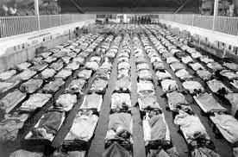
Complying with Allied estimates and requests for more infantry and machine guns units, medical personnel is 14% of the initial AEF force of 1 million
AEF in 1918 consistently suffered from a 25 to 30% shortage of medical personnel
During the Meuse-Argonne Offensive, 69,000 soldiers were listed as sick
First Army surgeons moves more experienced surgeons to forward triage stations to identify who could return to their units within 3 days
While not directly involved in CoS operations, medical services directly impacted their success
Treatment of wounded, and quarantining of the infected, ensured the AEF could advance without rotting from behind

Slide 19
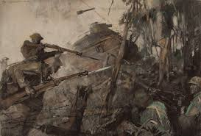
Conclusions
Adaptability to secure freedom of movement in CoS areas essential to successful outcome
AEF CoS quickly adapted to challenges presented at offensive’s onset
AEF and French broke through to the German railway line only days before the Armistice

