Slide 1
Quantitative Risk Assessment in Military Decisions
Douglas A. Samuelson
InfoLogix, Inc.
Annandale, Virginia
Historical Analysis Annual Conference (HAAC) September 29, 2022
Public Release, Distribution Unlimited
samuelsondoug@yahoo.com

Slide 2
Defining Risk
Is risk a product or a sum?
Is risk a set of events, the probability
of that set, or the expected value (or
cost) of those events?
Controversial – not settled after years
of arguments

Slide 3
Definitions
Risk: probability of adverse event(s)
Value of risk: expected cost of those events,
taking into account probabilities of occurrence
(What we call value of risk is also known
as actuarial risk)

Slide 4

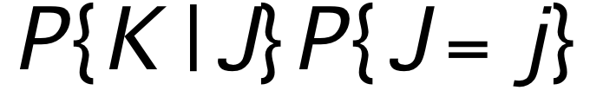

Risk from a Single Threat Event
Risk R =
Value of Risk
V_{R} =

Slide 5
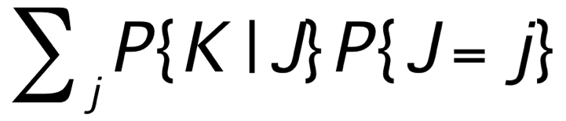
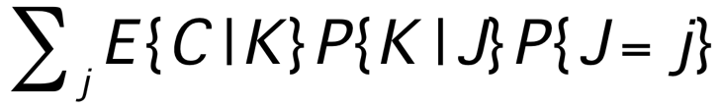
Multiple Discrete Threat Events
Risk R =
Value of Risk
V_{R} =

Slide 6

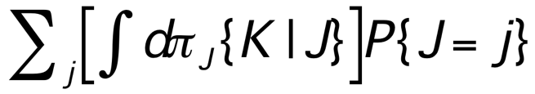
Non-Discrete Consequences
Risk R =
Value of Risk
V_{R} =

Slide 7
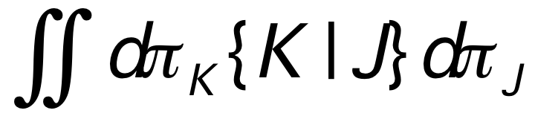
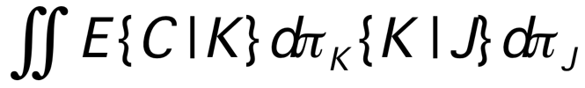
Non-Discrete Threat Probabilities
Risk R =
Value of Risk
V_{R} =

Slide 8
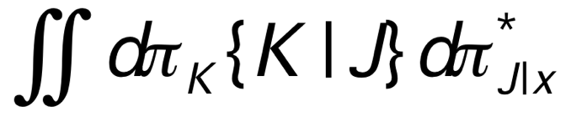
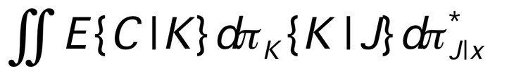
Effect of a Countermeasure x
Altered Risk R* =
Deterrent effect = R - R*
Altered Value of Risk
V*_{R} =
Value of Deterrence = V_{R} - V*_{R}

Slide 9
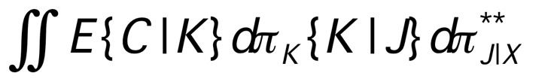
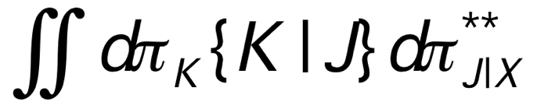
Effect of Countermeasures X
Altered Risk R** =
Deterrent effect = R - R**
Altered Value of Risk
V**_{R} =
Value of Deterrence = V_{R} - V**_{R}

Slide 10
Implications
General expressions, cover all cases
Mathematically rigorous, consistent
Formulas simplify in many cases
Can populate formulas with behavioral data
and use statistical packages to analyze
Provides guidance about what kind of data
would be useful (e.g. willingness to attack
under various conditions)

Slide 11
The Critical Implication
Estimating specific risks is unhelpful. Instead, manage resilience to reduce all-hazards risks
McCrystal: “RISK: A User’s Manual” (2021)
Now we have a way to express that risk and resilience mathematically

Slide 12
But now how do you compute these expressions?
What we have here is intimidating.
It’s something weird, and it don’t look
good.
Who ya gonna call?

Slide 13
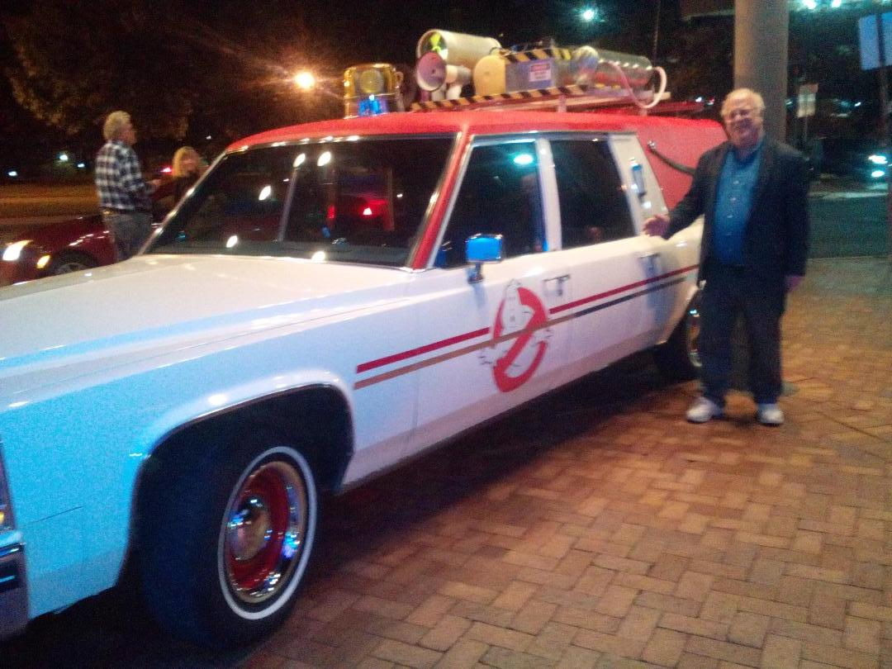

Slide 14
OK, well, if you don’t have their number, how about…
SIPMath !

Slide 15
The SIPmath™ Standard from 501(c)(3) non profit, Probability Management.org
Does for Uncertainty What Hindu/Arabic Numerals did for Numbers

Slide 16
The SIPmath™ Standard from 501(c)(3) non profit, Probability Management.org
Does for Uncertainty What Hindu/Arabic Numerals did for Numbers
A SIP (Stochastic Information Packet) is an auditable array of Monte Carlo trials and Metadata

Slide 17
Example
Estimate Barrels of Oil Spilled from a Ruptured Tanker Hull

Slide 18
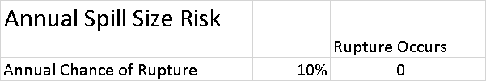
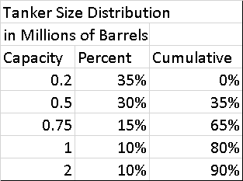
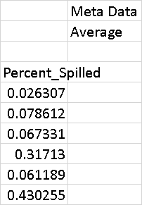

SIPmath Model Running 10,000 Trials per Keystroke in Native Excel Using the Data Table
Binomial
Distribution
Distribution of % of Capacity Spilled Given Rupture, Provided in a SIP
Distribution of Hull Capacity
Distribution of % of Capacity Spilled Given Rupture, Provided in a SIP

Slide 19
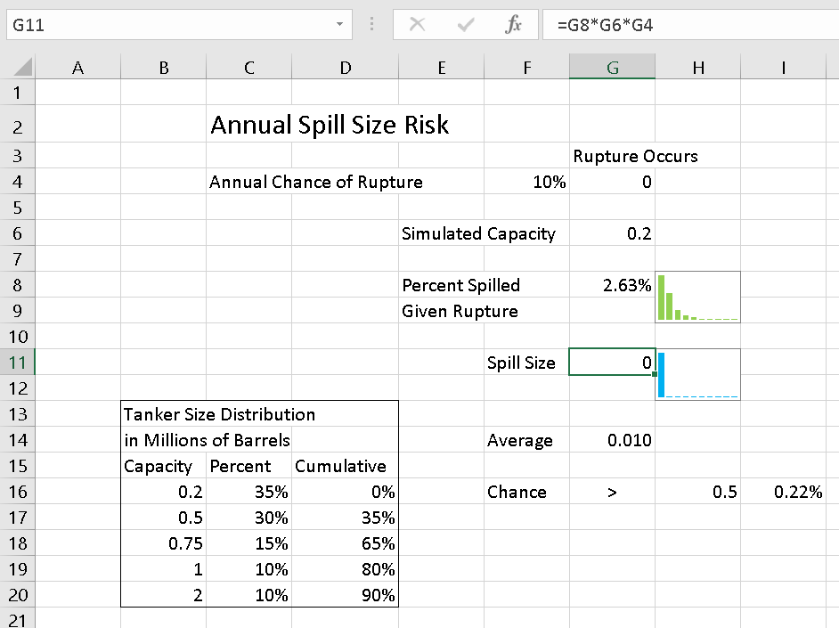
Risk is a Product
Rupture Occurs x Hull Capacity x % Spilled

Slide 20
Model Available at ProbabilityManagement.org

Slide 21
I ain’t afraid o’ no Stieltjes integrals!

Slide 22
But now that we know how to do computation, we still have challenges of definition!
Modern analytical methods drive the uncertainty from the computation to the assumptions, where it’s much harder to detect.

Slide 23
Oil spill risks from tankers
Two bright academics (a marine biologist and an oceanographer) studied spill risks using US Coast Guard Pollutions Incident Reporting System data
Concluded that we needed to collect data on very small spills to remove censoring, to infer about big spills
But how do small spills really tell us about big spills? (Different processes)
“I see. You don’t understand statistics.”

Slide 24
Oil spill risks: An Exercise
Take three years: 10,000 spills from the Coast Guard Pollution Incident Reporting System.
Mean 1000, standard deviation 500, 95% CI (5, 1995)
Add in one 7-million-gallon spill.
Now get mean 1700, 95% CI is (100, 3300).
Does that tell you that there’s a chance of a seven million gallon spill?
You need to use SIPMath to get upper tail probabilities and depict the rare high-consequence event

Slide 25
Pandemic Risks: Beware the Flaw of Averages
What typically drives the rate of spread of an epidemic is the number of contacts per time period by the most active spreader
Predicting average or even 95th percentile compliance behavior gives you an inaccurate (usually underestimated) rate of spread
What drives the rate of spread of COVID-19 is group exposures -- traditional models fail
Again, need SIPMath to get tail probabilities

Slide 26
Issues and Challenges
Unaware acquisition of knowledge
Cultural diffusion
Framing bias, unaware preconceptions
Group context
Ill-defined variables
Indirect effects
Hard-to-measure interactions
Latent variables
Notes:
26

Slide 27
Context Affects Perception
Suppose you go to the beach with a video camera to observe "everything of interest" for the weekend
Would knowing the question you'll be asked Monday morning affect what you would observe and remember?
Context matters, and we are more easily manipulated than we like to think!
Notes:
27

Slide 28
Communications Media
Affect Perception
We evolved from an oral culture to one centered on the written word, and now we are increasingly focused on images
People think they got much less information if you just speak and don’t reinforce it with visuals (PowerPoint)
The social effect of the medium itself dwarfs the effect of content transmitted (“The Medium Is the Message”)
Notes:
28

Slide 29
Communications Media
Affect Meaning
“Anyone whose physical appearance readily proclaims his role and station in society is bad for television” (McLuhan)
This is why we generally elect the more vaguely visually defined candidate (and then wake up wondering who he is)
Notes:
29

Slide 30
Implications
We need to be extremely and increasingly careful about how we conceptualize and state ideas
One misleading image indiscriminately disseminated can cause enormous harm
Need to be careful about questions, too
What we ask can frame possible answers
Notes:
30

Slide 31
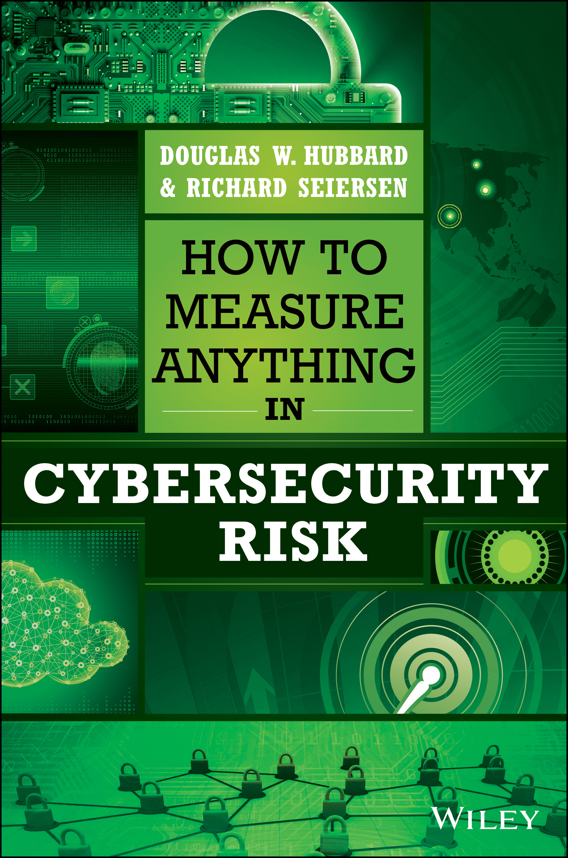
What Is the Single Biggest Cybersecurity Risk We Face?
The biggest single risk we face in cybersecurity is measuring cybersecurity risk incorrectly.
(Douglas W. Hubbard)
Notes:
31

Slide 32

What is the Most Important Attribute of a Monitoring or Surveillance System?
Notes:
32

Slide 33
What is the Most Important Attribute of a Monitoring or Surveillance System?
What it can't detect!
So no direct measurements of its functioning are meaningful is assessing its effectiveness.
You have to estimate the likelihood of an event you've never observed
Notes:
33

Slide 34
So What Can We Do?
Need to pose questions in multiple ways and compare and contrast perspectives
Diverse analytical team and methods
(“Diversity trumps ability” – Scott Page)
Need deep understanding of phenomena and systems we're considering
Oversimplified metrics end up misleading
(body count, number of ISR missions)
Notes:
34

Slide 35
Look for “Holes”
Absence of proof is not proof of absence,
but absence of evidence is evidence of absence
Example: where survey-takers won't go
Human rights: sudden disappearance of health, demographic, crime data is a good leading indicator of abuses
(Samuelson & Spirer, in Human Rights and Statistics, U. of Penn, Press, 1992)
Notes:
35

Slide 36
So What Can We Do? – II
Wargame and use “red team” experts (and non-experts) to develop better understanding of what could be done, what effects it could have, where knowing a little more would change your decision
Express both inputs and outputs in storytelling form, quantify only in meaningful ways
(E.g., how many stories contained this term?)
Notes:
36

Slide 37
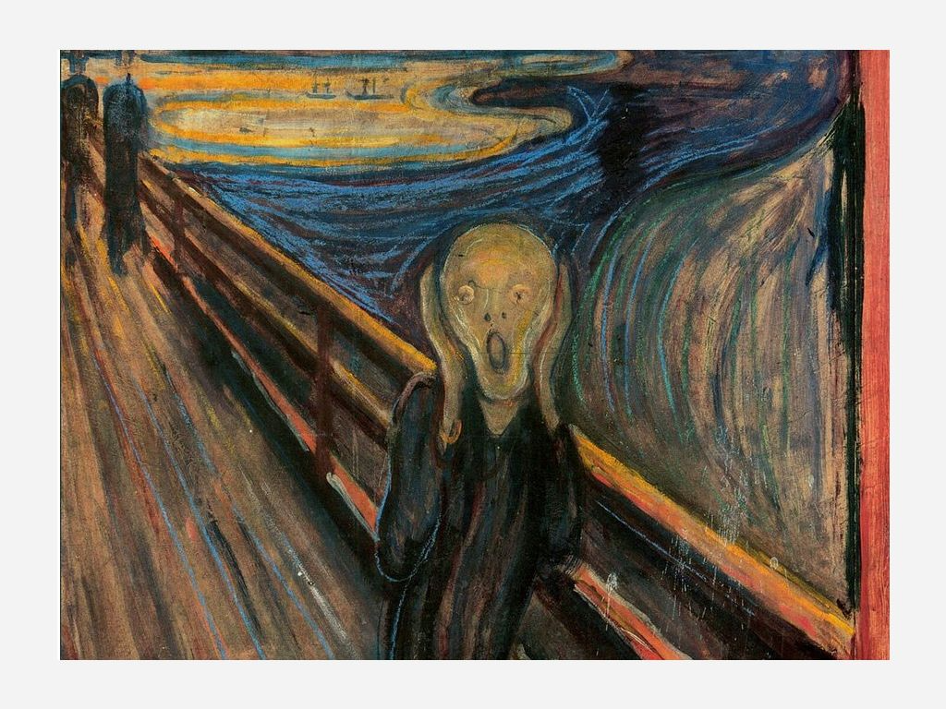
The Complexity of This Area of Analysis Is Really Daunting!
Notes:
37

Slide 38
Unfortunate Implication
When we're stressed and don't know what to do, we tend to do more of what we do know – retreat to our comfort zone.
Notes:
38

Slide 39
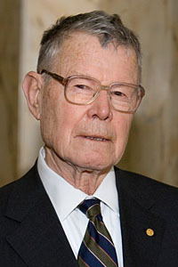
The Critical Challenge
Thomas Schelling (Nobel laureate, 2005): Nobody can make a list of all the things he never imagined.
Notes:
39

Slide 40
Focus on possibilities,
not intentions
of assumed adversaries
Instruction to Red player(s): Be whoever you want, and just look for a way to mess everything up
Adjudication removes impossibilities but does not punish “wild” moves
“Wild” scenarios and their results are all reportable findings
Notes:
40

Slide 41

We can't assume we know who the bad guys are
They might not even be guys.
They might not even be human, or instructed by humans!
Notes:
41

Slide 42
Wargames don't have to be cumbersome, highly structured, or detailed
Informal seminar games are often very informative
Difference from “BOGSATs” is adjudication, assessment of how it went
Rapporteurs are critical – don't assign this role to junior people
Notes:
42

Slide 43
Connection to Big Data
Derive as much as possible from narratives: what were players thinking given what they knew?
Same analytical process works for interpreting Big Data outputs, not just results from wargaming
“What is this telling us? Are there patterns? How consistent are the data?”
Notes:
43

Slide 44
Value of Information
How much better a decision could we make if we had this additional information? (EVPI: Expected Value of Perfect Information)
How could we acquire the most valuable information, and at what cost?
Good decision quickly is usually better than a demonstrably excellent decision reached at greater cost and after much more time
Notes:
44

Slide 45
Pattern Recognition:
Predictive Analytics
Don't just look for anomalies; sometimes the “too nice” data set is a clue (bogus medical claims, spoofed log files)
Look for associations of seemingly innocent data (late evening copying AND mildly unusual foreign travel AND modest change in financial situation)
Notes:
45

Slide 46
The Main Idea
If you keep thinking the way you've always thought, and monitoring as you've always monitored, you'll keep the same vulnerabilities.
Overly structured and conventional analysis loses.
Beware of getting comfortable!
Notes:
46

Slide 47

Don’t get comfortable….
If you miss one key assumption, you don’t know what can happen!
Notes:
47

Slide 48
And then….
Develop risk portfolios using SIPMath, compare results, identify where more information would be helpful and where counter-measures would likely be most valuable
(For more details, see also Sam Savage & Shaun Doheney presentation in 2020 MORS Symposium, look at probabilitymanagement.org)
Notes:
48

Slide 49
Preconceptions are everywhere!
In 2016, I presented a conjecture about what a mutant flu could do at the Olympics. Perfect storm: huge crowds from all over the world, packed together, not much health infrastructure.
One experienced analyst responded: “I worked in biowarfare for 30 years, and I wouldn’t do it that way.”
Notes:
49

Slide 50
Epidemic at Duffer’s Drift
The adversary may not think like you! Ask: “How COULD I do this?”
As in “The Defence of Duffer’s Drift,” examine your position for ways to attack
We just gave the world a comprehensive tutorial on where we’re vulnerable. COVID doesn’t seem to have been intentional, but what about the next one?
Notes:
50

Slide 51
Lesson from COVID-19
Standard epidemiology models use differential equations, focus on individual-to-individual transmission, so tend to be driven by a few “super-spreaders”
COVID-19 is spread mostly by group gatherings. We need a different way to model that. One promising approach is SIPMath similar to the tanker spills: model the probability of events and then the risk of spread within such events. (In progress)
Notes:
51

Slide 52
Recap: Thinking Differently
Seek meaningful indirect measures of what is most important – don't settle for what is more easily defined and measured
Look carefully at informal communication, group structures, norms, taboos, narratives
Think in terms of multiple streams of overlapping and partially contradictory information – the world isn't all linear!
Pay particular attention to incentives
We need MUCH easier and more open sharing
Notes:
52

Slide 53
Reexamine Contracting
Over-emphasizing task orders pushes the work toward least-cost solutions to well-defined questions – drives out multiple-talent analysts and discourages innovation
(But easier for contracting officers who can't evaluate unusual methods)
Use creative vehicles (for example, fixed-price with a final subtask to fix everything you didn't like after it met specifications)
Hard to evaluate creative work – need unusual combined skill sets to do this well; rely more on diverse peer teams
Notes:
53

Slide 54
Avoiding Obstructions
Don't let lack of statistical significance be used to suppress interesting conjectures
Resist orthodoxies about scales (e.g. Likert)
Don't be afraid to mix qualitative and quantitative approaches – for example, count stories in which certain items appear
Rethink contracting and evaluation approaches to encourage innovation
Promote sharing among teammates (data stores)
Notes:
54

Slide 55
Recap: Defining and Depicting Risk
Probabilities are ALWAYS quantitative
Any number should be accompanied by another number depicting how uncertain we are
Defining what the risk is depends on which way you’re betting! (If you’ve shorted the stock, your risk is that it will go up!)
Beware of “analysis placebos” that make you feel more confident without reducing uncertainty
Notes:
55

Slide 56
Summary and Conclusions
We can't defeat creative adversaries and respond to new, largely unknown risks by thinking the same way we've always thought!
Elicit creative adversary actions – wargames, “white hat hackers,” “what could someone do”
Fold these “what-ifs” into quantitative estimates
“The greatest threat to our security is inertia in the thinking of those responsible for our security”
– David Ben-Gurion
Notes:
56

Slide 57
Reference
McCrystal, Stanley, and Anna Butrico, RISK: A User’s Guide, Penguin, 2021
Notes:
57

